Slide 1

Title: Rapido 2.0 – Reimagining Safe, Inclusive Urban Mobility Sub-title: AI-Powered Compliance, Trust & Growth Strategy
Name- Deepak Patro Strategy, AI & Data Consultant – Rapido 2.0
Date: 9th July 2025

Slide 2
Agenda
Introduction
Problem & Legal Landscape
Data Insights (EDA Highlights)
AI-Powered Solutions
System Architecture & Features
UI/UX Redesign
Business & Compliance Impact
Roadmap Ahead

Slide 3
Problem Statement – Why Rapido Needs a Revamp
Legal Bans Across Key States Operations suspended or restricted in Karnataka, Tamil Nadu, and others due to regulatory non-compliance.
Accessibility Gaps Delhi High Court petition highlights lack of inclusive features for Persons with Disabilities (PwD).
Data Breach in 2024 User trust severely impacted after exposure of sensitive rider and driver data.
Rising Cancellations & ETA Disruptions Increased user drop-offs due to language barriers, poor matching algorithms, and inaccurate ETA predictions.

Slide 4
EDA Highlights – Understanding the Ground Reality
1. Ride Duration Distribution by Service
Chart Type: Histogram or KDE plot
Insight: Compare average ride duration for bike-taxi vs auto vs car
Highlight: Variability in duration across services; ideal for pricing/timing strategy
2. City-wise Risk Categorization
(Red – Legal/Operational Issues, Yellow – Unstable, Green – Operational)
Chart Type: Choropleth Map or Color-coded Table
Insight: Identify cities with high legal risk, moderate uncertainty, and stable operations
3. Cancellation Rate by User Ratings
Chart Type: Bar Chart
Insight: Users with lower ratings are associated with higher cancellations
Highlight: Target behavior-based interventions, trust-building, or ride denials

Slide 5

4. Correlation Matrix Chart Type: Heatmap Insight: Understand relationships between variables like ride duration, cancellations, driver rating, etc. Highlight: Key predictors of cancellations or user satisfaction 5. Heatmap of Legal Status (India-wide) Chart Type: Geo Heatmap of India Insight: Display state-wise legality of Rapido services Highlight: Strategic expansion & compliance roadmap 6. Word Cloud: Public + Legal Sentiment Data Source: Tweets, Reviews, Legal News Insight: Visualize key phrases like “ban,” “safety,” “female rider,” “data breach” Highlight: Need for trust, compliance, and inclusivity

Slide 6
Model Overview – Intelligence Behind Rapido 2.0
1. XGBoost Model – Ride Cancellation Prediction
Predicts likelihood of a ride getting cancelled
Inputs: User rating, pickup delay, distance, time of day
Action: Proactive re-routing or denial for high-risk requests
2. ETA Prediction Model
Learns from historical traffic, weather, driver patterns
Improves customer trust with real-time accurate arrival estimates
3. Driver Fraud Detection System
Flags fake documents, mismatched faces, bike misuse
Uses CV + OCR + ID Matching + Policy Violation Checks
Action: Auto-blocks driver & raises alert
6

Slide 7
4. Anomaly Detection & Real-time Alerts
Detects unusual surge in cancellations, location spoofing, payment fraud
Ensures operational integrity and fast escalation
5. AI Assistant – Voice & Document Verification
Multilingual assistant for ride booking & support
Verifies driver docs and license via voice and OCR
Accessibility-focused, supports PwD riders
6. LLM-Powered Support + City Decision Engine
Automates 80% of customer queries via GPT-powered chat
City Decision Engine helps expansion based on:
Legal compliance
Demand scoring
Operational risk
7

Slide 8
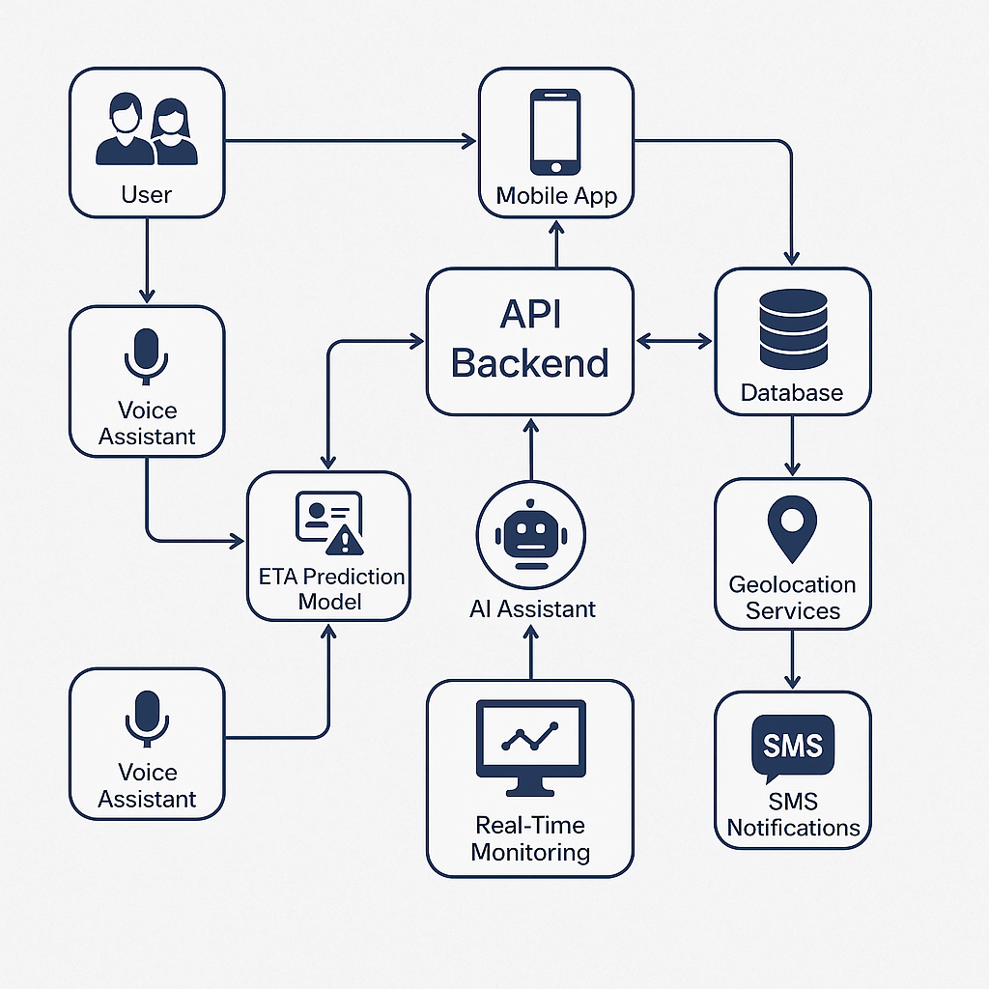
Architecture Flow Diagram
8

Slide 9
Safety & Compliance Tech – Building Trust by Design
🔒 252-bit Data Encryption
Industry-grade protection of user and driver data
Secures transactions, IDs, and location logs
📍 Geo-fencing for Banned/High-Risk Zones
Automatically blocks rides in restricted areas (e.g., state ban zones)
Ensures compliance with local transport laws
Rider Detail Masking
Protects rider identity (phone number, location) from misuse
Temporary communication relay between rider and driver

Slide 10
🚗 Real-Time Vehicle Monitoring
Tracks speed, route deviation, and idle time
Alerts triggered for unsafe behavior or policy violations
🆘 SOS Integration + Nearby Police Ping
Riders/drivers can instantly alert authorities and nearby help
Supports audio, location, and real-time feed sharing
🗣️ Voice Assistant for Vernacular Booking
Available in 12+ Indian languages
Helps non-English speakers and visually impaired users book rides hands-free

Slide 11
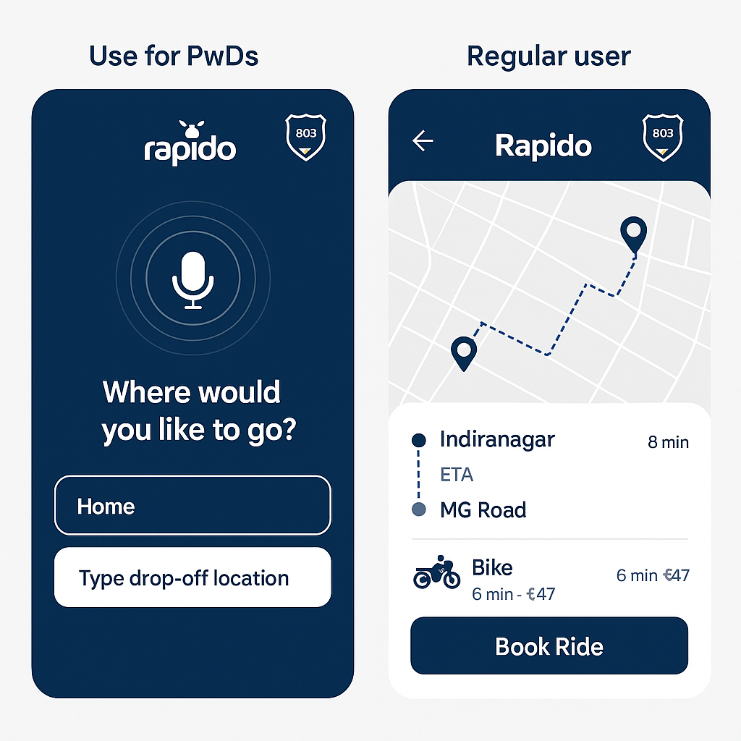
Innovative solutions- Dual UI system
Tailored Experience for Different User Groups
Regular Users: Standard UI with quick-booking, wallet, live tracking, ride history Optimized for speed and simplicity
Users with Disabilities (PwDs): Accessibility-first interface designed for independent, dignified usage
Accessibility Features in PwD UI
Voice Navigation & Commands Hands-free ride booking via multilingual voice assistant
Screen Reader Compatibility Supports NVDA, Talk-Back for visually impaired users
High Contrast & Color-Safe Themes Improves readability for users with color blindness or visual strain
Custom Notes to Drivers Allows PwD users to send pre-defined instructions (e.g., “hearing impaired,” “need assistance with folding wheelchair”)

Slide 12
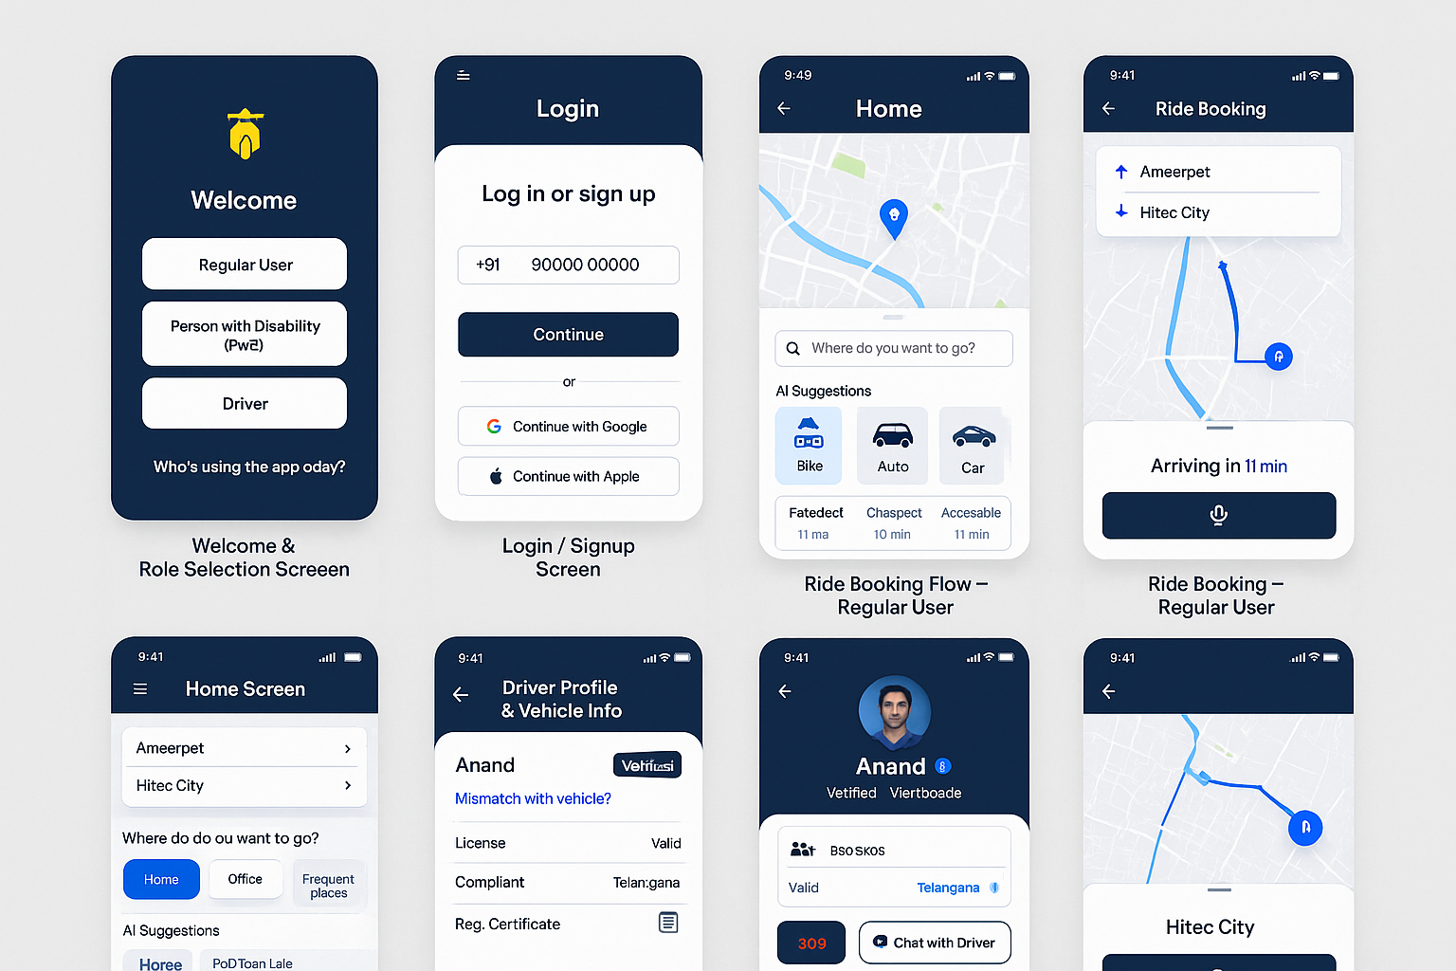
UI/UX Visual Overhaul
New Color Scheme: Navy Blue + White
Clean, Minimalist Layout
Feature Callouts:
SOS Button
Accessible Login
Multilingual Support
Rider Penalty System
12

Slide 13
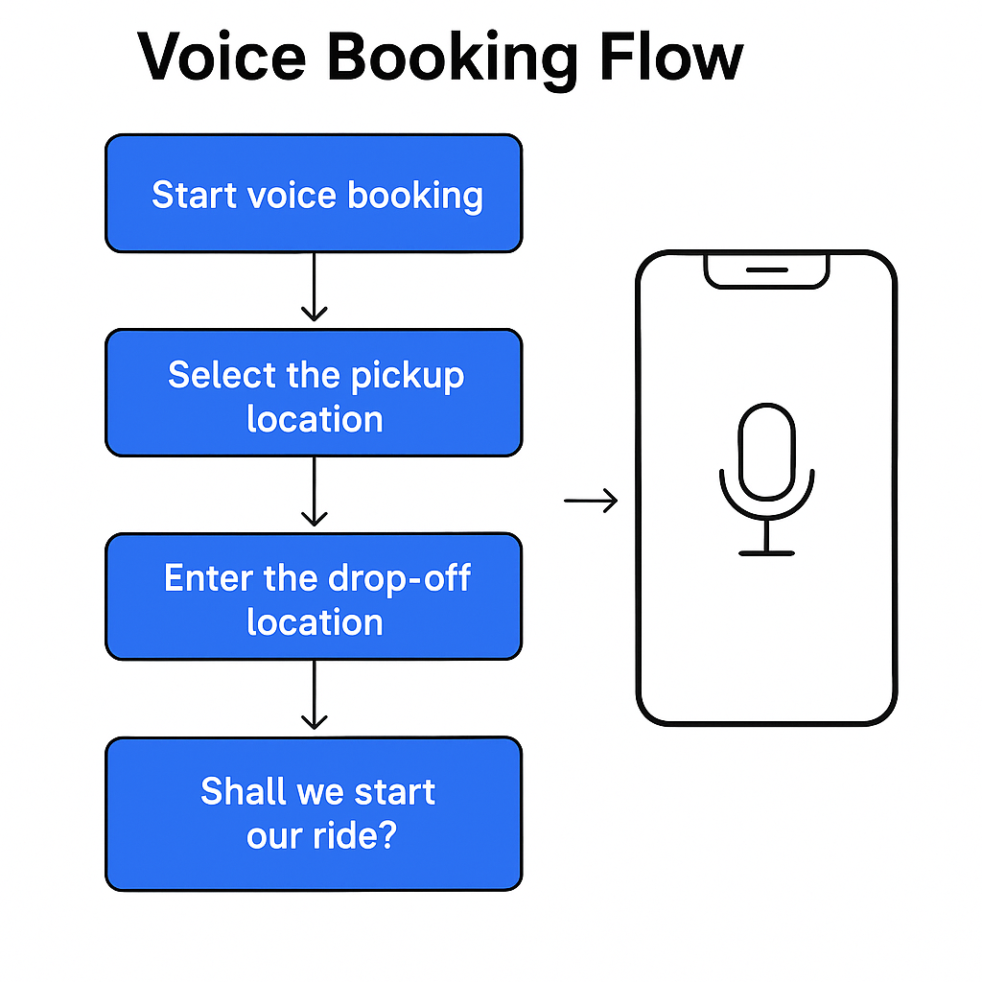
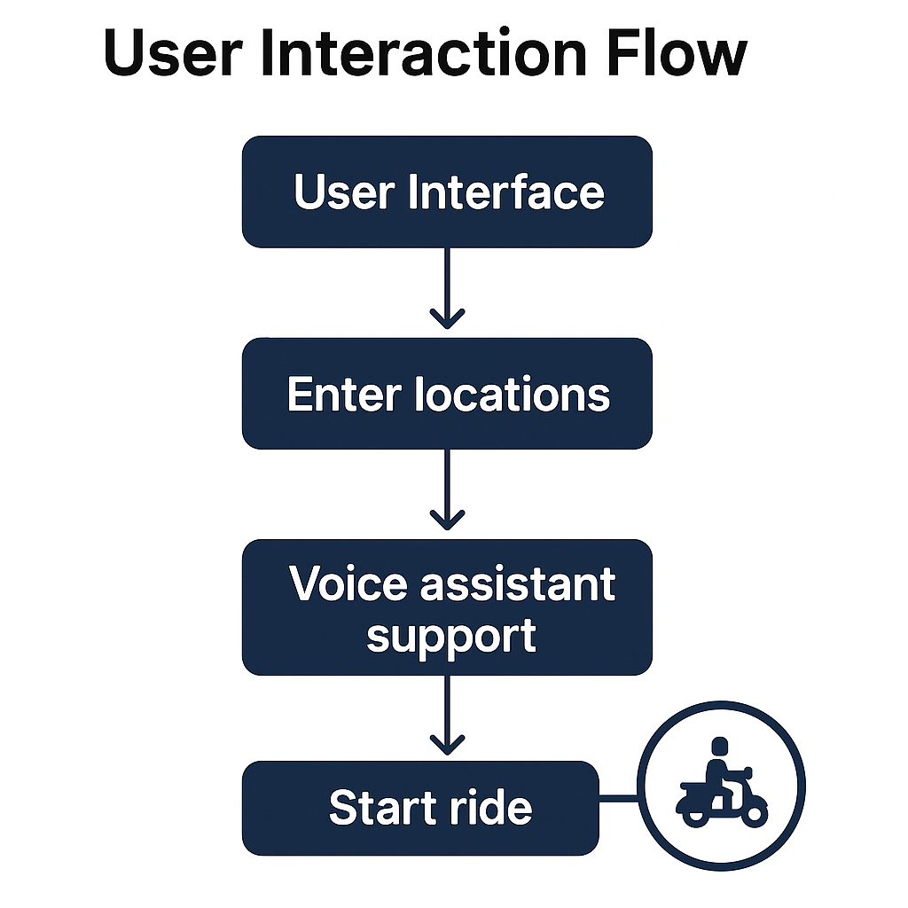

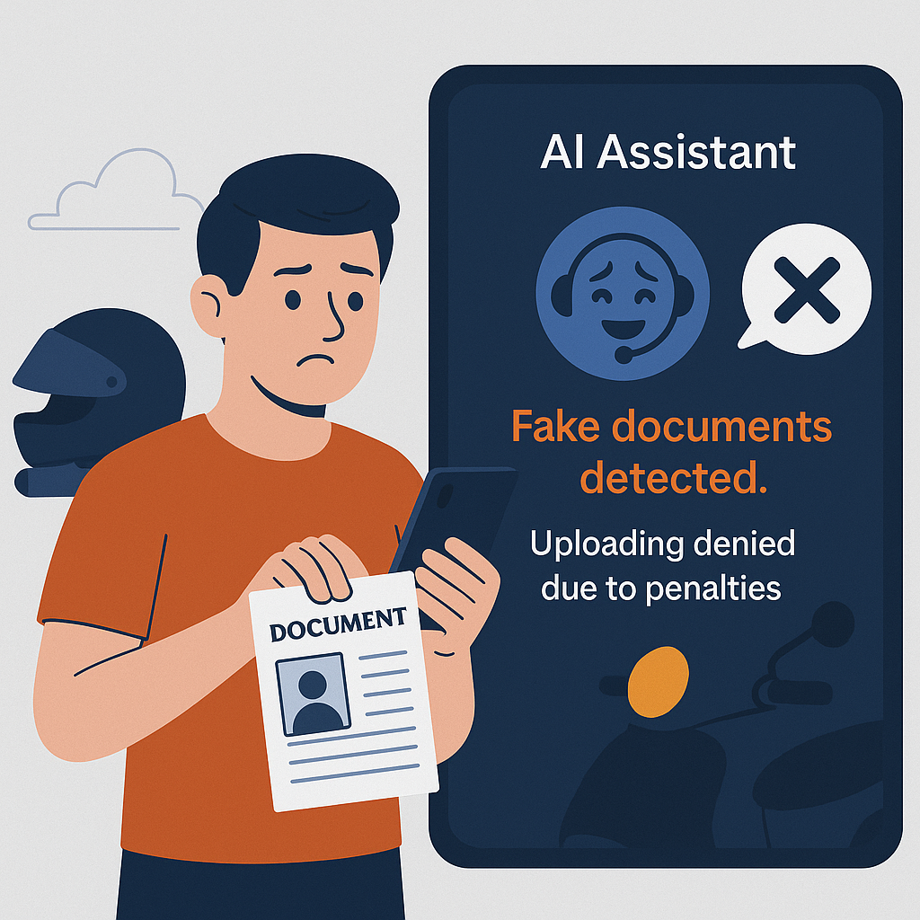

Slide 14
Impact Analysis – What Rapido 2.0 Delivers
Regulatory Readiness
Fully aligned with Motor Vehicles Act and WCAG 2.1 AA guidelines
Ready for legal re-entry in banned states
Better User Trust
Transparency, accessibility, and real-time safety features
Rebuilding brand reputation post-data breach
Reduced Cancellations
Predictive models + smart matching
18–25% projected drop in user-side cancellations Operational Safety
Real-time monitoring, fraud detection, and emergency SOS integration
Preventive safety, not reactive
Data Security Reinforcement
252-bit encryption, masked identity layers, geo-fencing
Fully compliant with future Digital Personal Data Protection Bill (DPDP)

Slide 15
Roadmap
Phase 1: Legal & Accessibility Fixes
Phase 2: AI & Predictive Enhancements
Phase 3: UI/UX Redesign Rollout
Phase 4: Expansion & Investor Pitch

Slide 16
“Rapido 2.0 isn’t just a reboot — it’s a comeback.”
Let’s make India’s bike taxi
Safe. Inclusive. Intelligent.

Slide 17
Thank you
Deepak Patro
Strategy, AI & Data Consultant – Rapido 2.0
deepakpatro73@gmail.com
https://www.linkedin.com/in/deepak-patro-2a0330228/

